Slide 1
Module 17
Marketing Strategies for Mature & Declining Markets
By: Dr Shahinaz Abdellatif

Slide 2
Objective of this session
1. To discuss the major strategic issues in mature and declining markets

Slide 3
Strategies for Maintaining a Competitive Advantage
Analyser & Defender strategies are both concerned with maintaining a strong share position in mature markets.
Analysers also do some product and market development to avoid being leapfrogged by competitors with more advanced products or being left behind in new applications segments.
An analyser strategy is most appropriate for developed industries that are still experiencing some technological change and may have opportunities for continued growth, such as the computer and commercial aircraft industries.

Slide 4
Strategies for Maintaining a Competitive Advantage
Analyser & Defender strategies are both concerned with maintaining a strong share position in mature markets.
Analysers also do some product and market development to avoid being leapfrogged by competitors with more advanced products or being left behind in new applications segments.
An analyser strategy is most appropriate for developed industries that are still experiencing some technological change and may have opportunities for continued growth, such as the PC and telecom industries.

Slide 5
Strategies for Maintaining a Competitive Advantage
Sources of competitive advantage for analyzers and defenders:
  - Low cost
  - Differentiation - product
  - Differentiation - service

Slide 6
Strategies For Maintaining Market Share
Overall objective
  Maximise the flow of profits over the remaining life of the product market
  Maintain and protect business’s market share
Marketing objective
  Retain existing customers
Strategy
  Fortress Defence
  - Increase customer satisfaction and loyalty
  - Encourage and simplify repeat purchasing

Slide 7
Strategies for Extending Volume Growth
Market may only appear to be in maturity
May be opportunities to extend growth by:
  Increased-penetration strategy
  Extended-use strategy
  Market-expansion strategy

Slide 8
Strategies for Extending Volume Growth
C:\Users\srashad\Desktop\Growth extension Strategies.doc

Slide 9
Strategies for Declining Markets
Factors affecting attractiveness:
  Conditions of demand
  Exit barriers
  Intensity of future competitive rivalry

Slide 10
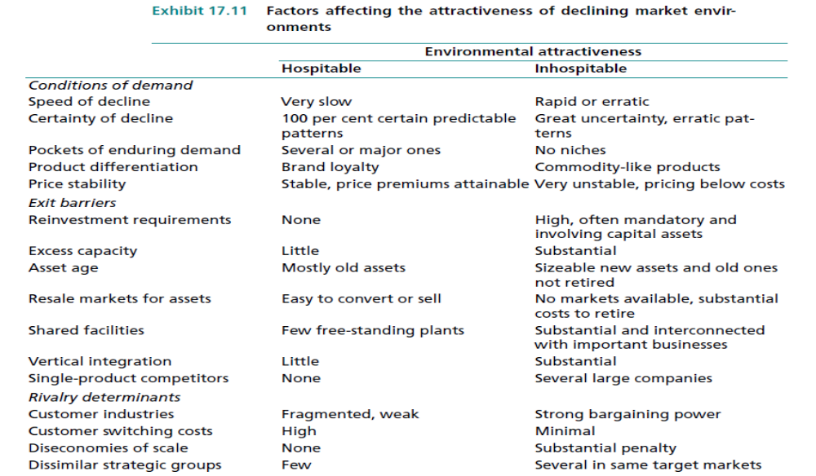

Slide 11
Strategies for Declining Markets
Harvesting: Maximise short term cash flow; maintain or increase margins even at the expense of a slow decline in market share.
Maintenance: Maintain share in short term as market declines, even if margins must be sacrificed.
Profitable Survivor: Increase share of the declining market with an eye to future profits; encourage weaker competitors to leave.
Niche: Focus on strengthening position in one or a few relatively substantial segments with potential for future profits.

Slide 12
Strategies for Declining Markets
C:\Users\srashad\Desktop\Marketing Strategies for decline markets.doc

